Slide 1
Cooperation of NUL and MRU in double/triple master degree on European and International Business Law (EIBL)
Prof. dr. Virginijus Bitė
18 July 2023

Slide 2
LITHUANIA AT A GLANCE
AREA
65 300 km²
GEOGRAPHICAL CENTRE OF EUROPE
(26KM NORTH FROM VILNIUS)
INHABITANTS
2.8 million
MEMBER OF THE
EUROPEAN UNION
SINCE 2004

Slide 3
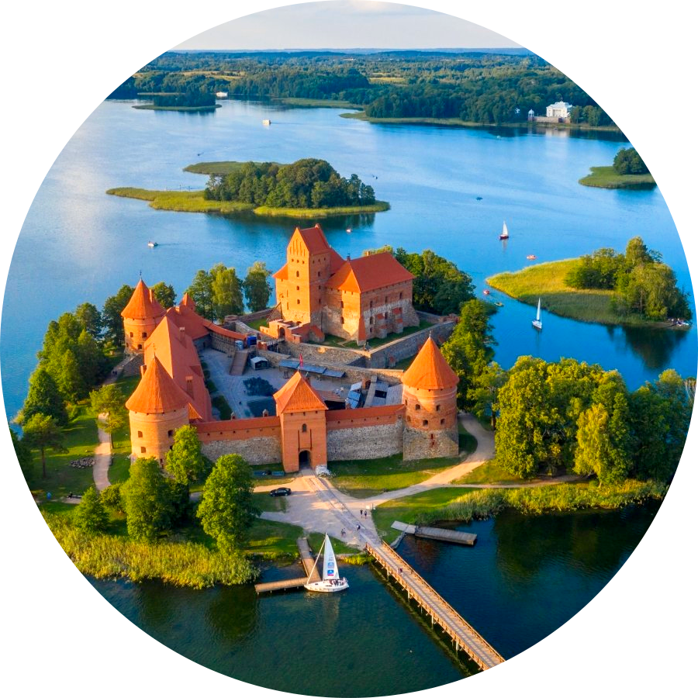




KERNAVĖ – FIRST CAPITAL (1279)
Visit Trakai (the old capital)
VILNIUS – CAPITAL OF LITHUANIA
Walk in the old town of Vilnius (UNESCO)
Fly with hot air balloons over Vilnius

Slide 4

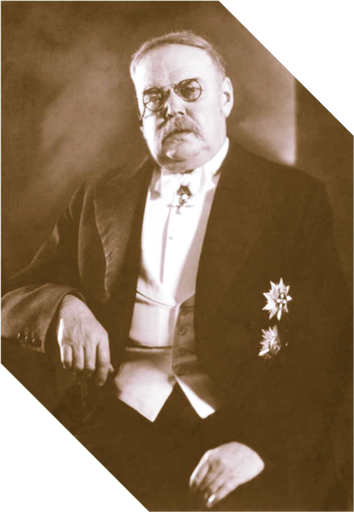

Internationally minded, innovative leading social sciences University
Established in 1990
~5700 of students
~700 international students coming from 70+ countries
Executive Team
The roadmap developed for the executive team aims to secure buy-in for the product vision
Named after professor
Mykolas Römeris (1880-1945) - prominent lawyer, the founder of Lithuanian Constitutional Law
Bachelor (3,5-4 y.)
Master (1,5-2 y.)
LLM (1 y.)
MBA (1 y.)
Doctoral (4-6 y.)

Slide 5
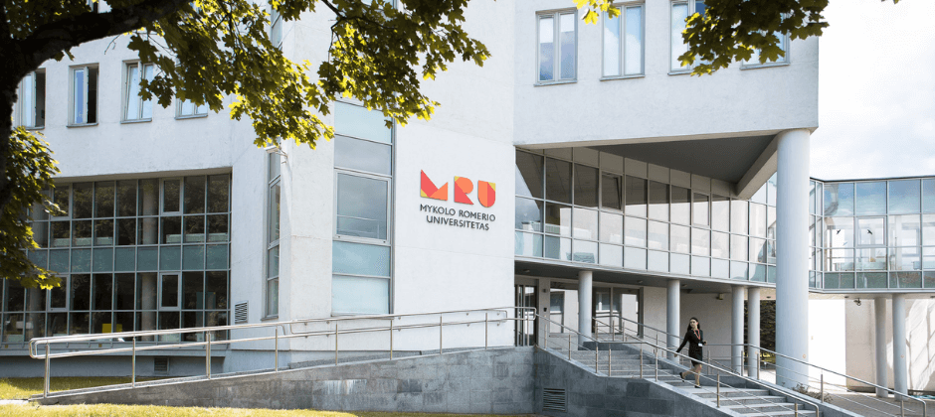
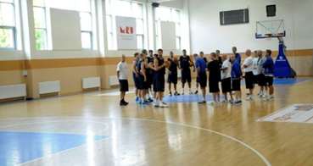





STUDENT-CENTERED
Situated in the park
INTERNATIONALIZATION
PHILOSOPHY OF STUDIES AT MRU
Devoted for sports activities
DIGITALIZATION
Modern library

Slide 6
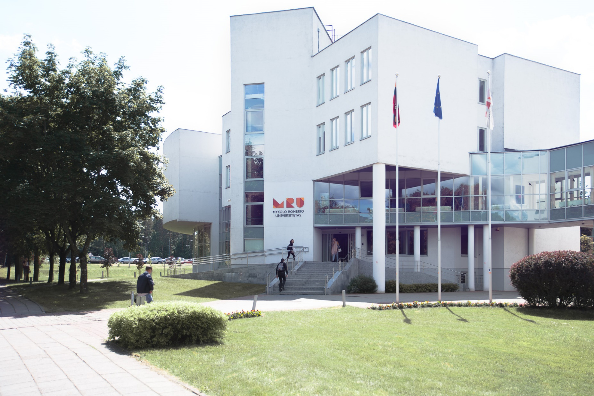

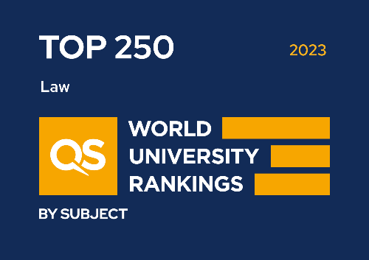
LAW SCHOOL

Slide 7



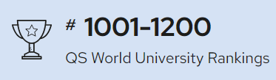
Rankings
QS World University Rankings by Subject 2023: Law & Legal Studies
The Times Higher Education Impact Rankings
QS World University Rankings 2023
501st - academic reputation and reputation among employers
560th - the number of foreign students

Slide 8
TOP
250
TOP 10
TOP 1
In the world
Central and Eastern Europe
Baltic states

Slide 9

Who we are?
2000 law students
6 bachelor in law programs
300 law graduates annum
14 master in law programs
~170 foreign degree students
6 master and 1 bachelor programs in English
~70 exchange students
5 LLM programs for practitioners
~ 30 international projects
~50 courses in English for exchange students
79% average employability of graduates
Top experts of law

Slide 10

European and International Business Law (2 diplomas)
1-2 semesters
3 semester
4 semester
Int. Trade and Investment Law
Int. Intellectual Property Law
Int. Contract Law
Internship, etc.
Eur. and Int. Company Law
Int. Tax Law
Int. Banking Law
Eur. and Int. Labour Law
Eur. and Int. Insolvency Law
Defense of Master thesis
Optional: Erasmus+ studies/internship

Slide 11

European and International Business Law (3 diplomas)
1-2 semesters
3-4 semesters
5-6 semesters
Int. Trade and Investment Law
Int. Intellectual Property Law
Int. Contract Law
Internship, etc.
Eur. and Int. Company Law
Int. Tax Law
Int. Banking Law
Eur. and Int. Labour Law
Eur. and Int. Insolvency Law
Eur. and Int. Competition Law
Industrial Property Law
Int. Commercial Litigation
French Language
Master Thesis Writing
Comp. Contract Law and Econ. Analysis
Int. Transport Law
Spec. Contracts of Int. Business
Econ. Integration of the EU
Eur. and Int. Principles of Contract Law
Cont. Issues of Int. Business Law
French Language
Internship (Erasmus+)
Defense of Master thesis

Slide 12
Advantages of the program
2-3 diplomas
Modern University
Great experts
Scholarships
Mobility

Slide 13
Scholarships and price
State scholarships for Ukrainian students (2024)
NLU students get discount for the tuition fee (30%)
Price:
2023/2024 – 3005.8 Eur/year (regular - 4294 Eur/year)
USMB - ~350 Eur/year

Slide 14

Scholarship 540-750 Eur
For studies and internships
In total 12 months activities
More than 200 partner universities

Slide 15
Prof. Dr. Virginijus Bitė
Director of the Institute of Private Law
Chairman of PhD Committee in the field of law
Director of the joint master study programs "European and International Business Law“, "Private Law" and "Intellectual Property Law"
School of Law | Mykolas Romeris University
virginijus.bite@mruni.eu
+370 5 2714 525
Mykolas Romeris University
Ateities st. 20, Vilnius, LT-08303 Lithuania
www.mruni.eu

